Slide 1
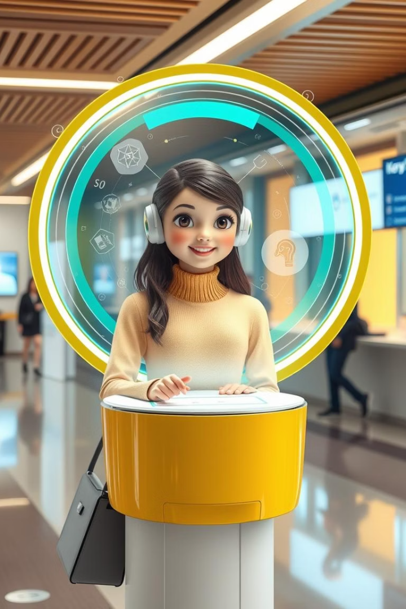
Introducing the Smart Virtual Receptionist for Bennett University
Revolutionizing campus navigation and information access. This smart virtual receptionist offers an immersive 3D experience, built in Unreal Engine 5. It's available 24/7, providing instant query resolution and enhancing the overall campus experience.
Anurag Singh
E23CSEU1071

Slide 2

Core Technology Stack
Unreal Engine 5
Convo AI
Text-to-Speech (TTS)
Enables natural language processing and dialogue management for intelligent interactions.
Provides a high-fidelity 3D campus environment for an immersive user experience.
Generates realistic voice responses, ensuring seamless and intuitive communication.

Slide 3
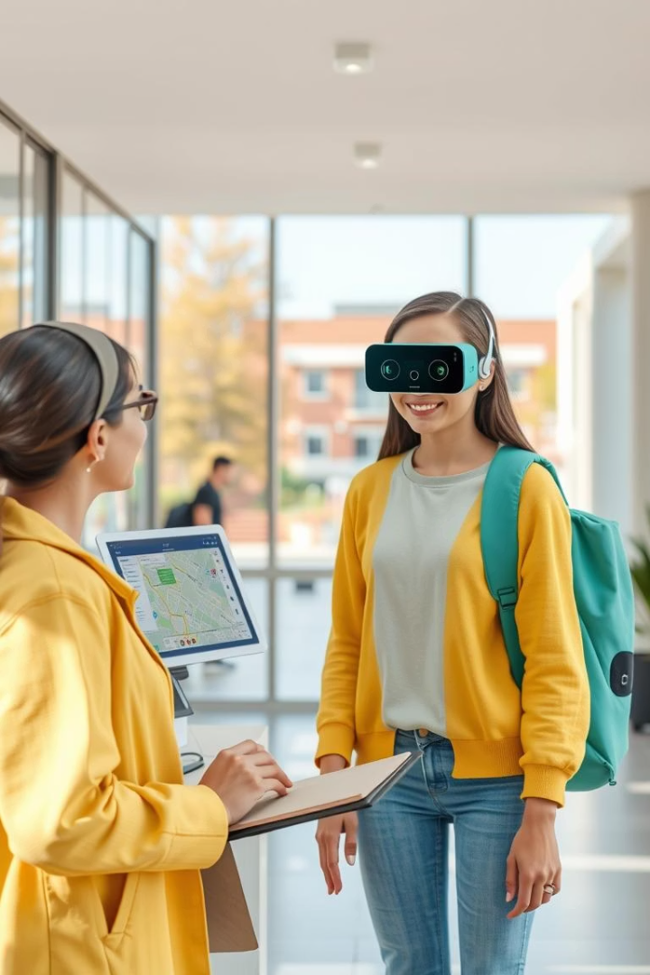
Key Features and Functionality
1
Comprehensive Database
2
AI-Powered Support
Provides access to a wide range of university resources and services.
Delivers instant answers and support through intelligent question answering.

Slide 4
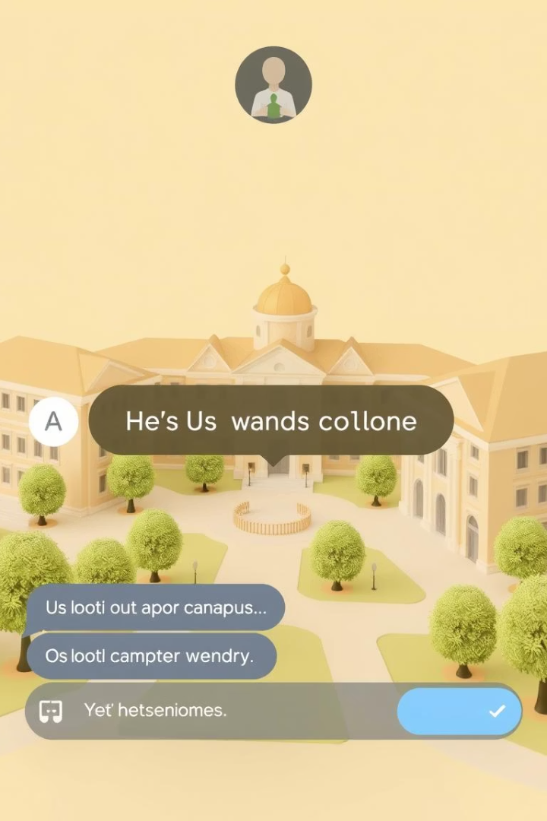



User Interaction and Interface
Text / Voice Input
Intuitive Dialogue
Clear TTS Output
Easy query submission through text-based input. The intuitive dialogue flow is powered by Convo AI. Effortless understanding with clear and concise TTS output. Enjoy a user-friendly UI integrated within the 3D campus environment.

Slide 5


Deployment Strategy for the Virtual Receptionist
Hosting Platforms
Reception Area Accessibility
Utilize top cloud services like AWS, Google Cloud, and Azure.
Subtitles and speech-to-text for inclusive communication.
Support real-time rendering and streaming of the 3D avatar.
High-contrast modes to aid users with visual impairments.
Ensure scalability and high availability for reliable access.
Resizable interface elements for easy readability.
These features ensure an accessible, user-friendly experience.

Slide 6

Benefits for Bennett University
Enhanced Student Experience
Reduced Staff Strain
Improved Resource Utilization
Alleviates the burden on physical reception staff, freeing up resources.
Increased satisfaction through instant support and easy navigation.
Optimized campus navigation and efficient resource management.

Slide 7
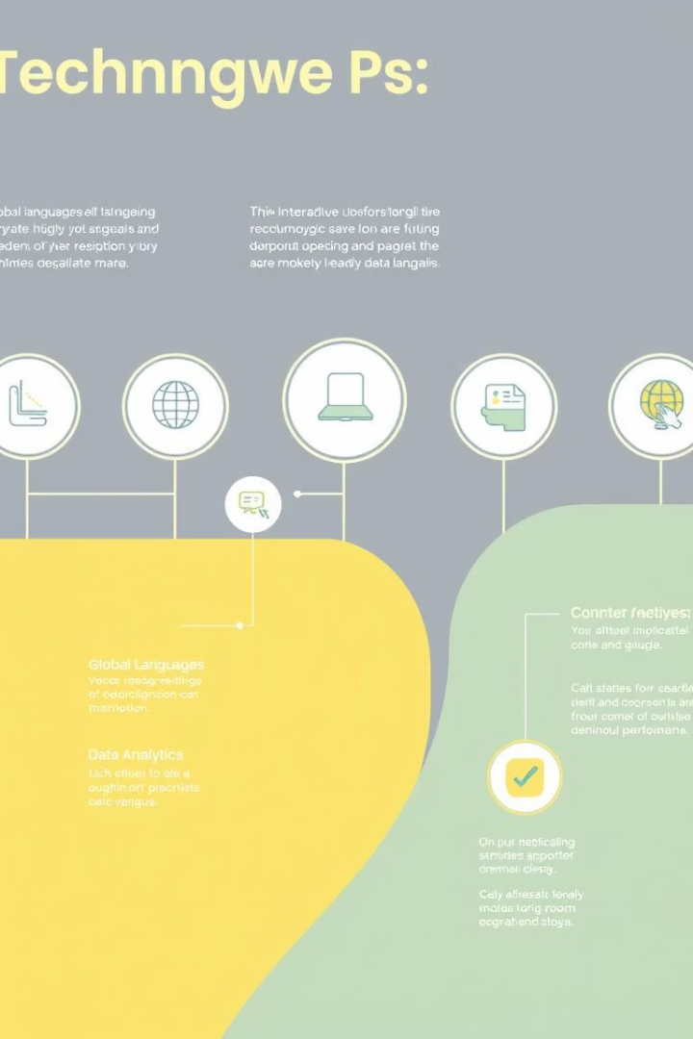




Future Enhancements and Roadmap
CRM Integration
Connect with university databases.
Expanded Support
More languages and personalization.
Advanced Input
Voice and facial recognition.
Data Analytics
Track usage and improve performance.
Notes:
Our product roadmap outlines several exciting future enhancements to improve the user experience. First, we plan to integrate with university databases to allow students and faculty to seamlessly connect their CRM data. Next, we'll be expanding our language support and personalization options to cater to a more global audience. We're also developing advanced input methods like voice and facial recognition to make the interface even more intuitive. Finally, we'll be implementing robust data analytics to track usage patterns and continually optimize the performance of our platform. These upcoming features will help take our solution to the next level and deliver even greater value to our customers.

Slide 8
Conclusion: The Future of Campus Assistance
The Smart Virtual Receptionist transforms campus interaction, enhancing accessibility, efficiency, and user satisfaction. It positions Bennett University at the forefront of technological innovation in education. Embrace the future of campus assistance.

Slide 9




Voice and Gesture Control for Windows
Voice Command Integration:
Navigate desktops, open apps, and control windows by voice.
2
Gesture Control Activation:
Use hand gestures for mouse control, scrolling, and zooming.
Context-Aware Interaction:
System adapts to app interfaces for seamless control.
Hands-Free Productivity:
Switch easily between voice and gestures to boost efficiency.

